Slide 1

Chapter 2
Your First Game
Game Development 1.1
Denis McCarthy
E-mail: demccarthy@ait.ie
Room: U302

Slide 2
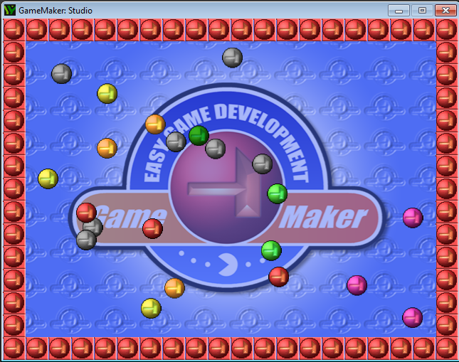
Bouncing Ball Game
The idea behind the game is to introduce you the basic elements of Game Maker quickly.
To play the game just click on the moving balls to destroy them.
From now on we will refer to Game Maker within the notes as GM.
Game Development 1.1
Denis McCarthy

Slide 3
Game Resources
All resources needed for this game are stored on moodle under Lab resources your first game.
Download all files and store in a suitable directory
  E.g. gamedev\first_game
Game Development 1.1
Denis McCarthy
Notes:
Show moodle image

Slide 4
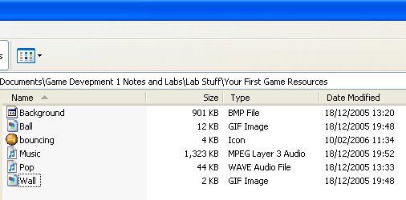
Game Resources
Sprites:
  Ball.gif
  Wall.gif
Background:
  Background.bmp
Sounds:
  Music.mp3
  Pop.wav
Icon: (icon to display on executable file)
  Bouncing.ico
Game Development 1.1
Denis McCarthy

Slide 5
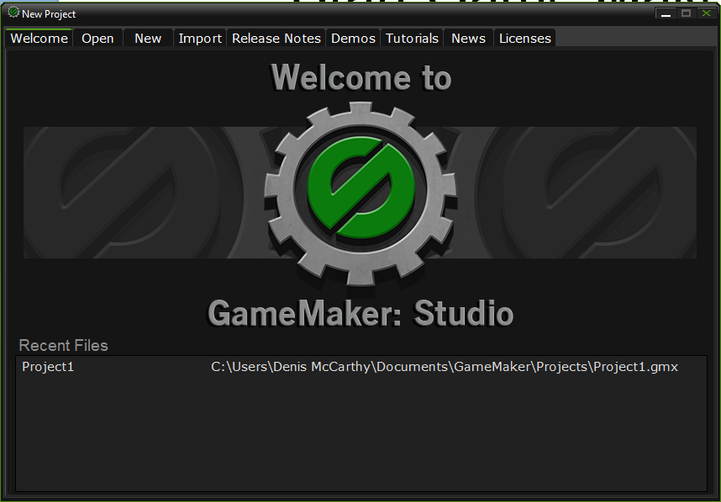
Start Game Maker
Game Development 1.1
Denis McCarthy

Slide 6
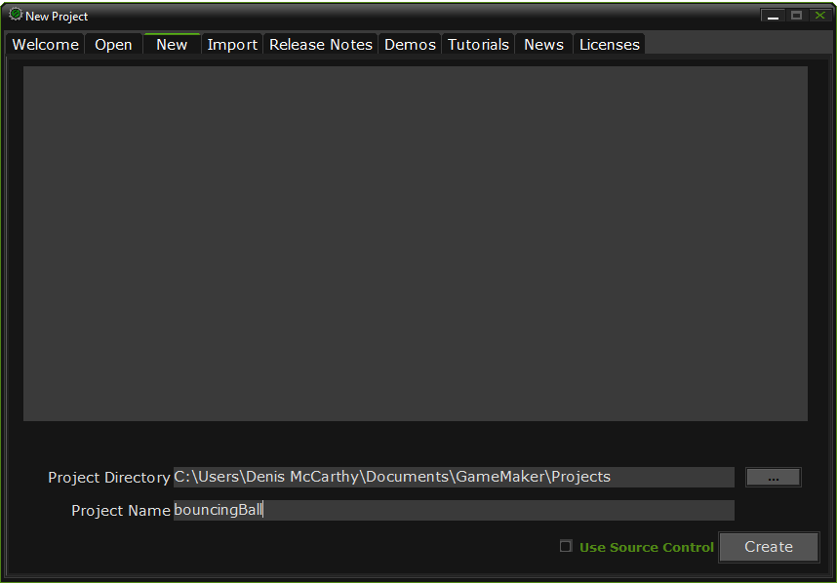
Create a new project
Call the project bouncingBall
And click on the Create button.
Game Development 1.1
Denis McCarthy

Slide 7
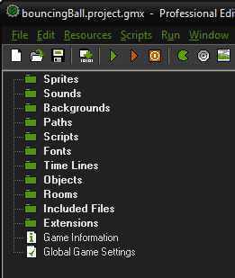
About the interface
Left hand side of screen shows the different resources that make up the game: sprites, sounds etc.
All are currently empty, new resource names will appear here as they are added to the game.
Menu bar along the top contains all commands that allow us to work with resources.
Most common tasks can be accessed from toolbar.
Game Development 1.1
Denis McCarthy

Slide 8
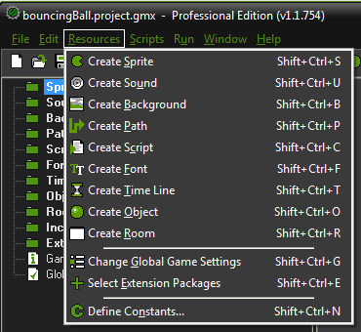
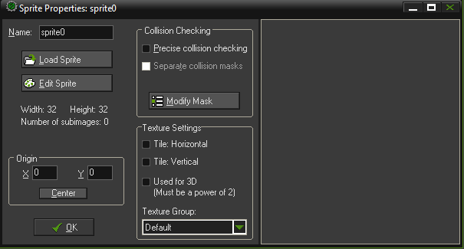
Ball Sprite
Since objects within GM have a visual appearance, lets create some sprites for our game.
From the Resources menu, choose Create Sprite, the Sprite Properties form appears as below.
Game Development 1.1
Denis McCarthy

Slide 9
Ball Sprite (Contd…)
Click on the Name field, where it currently says sprite0, this is the default name created by GM, you should rename it sprite_ball.
Click on the Load Sprite button. This opens the standard windows file requester.
Select the required image using the file requester. The image for the ball is called Ball.gif which you should find in the directory you downloaded it to.
Game Development 1.1
Denis McCarthy

Slide 10
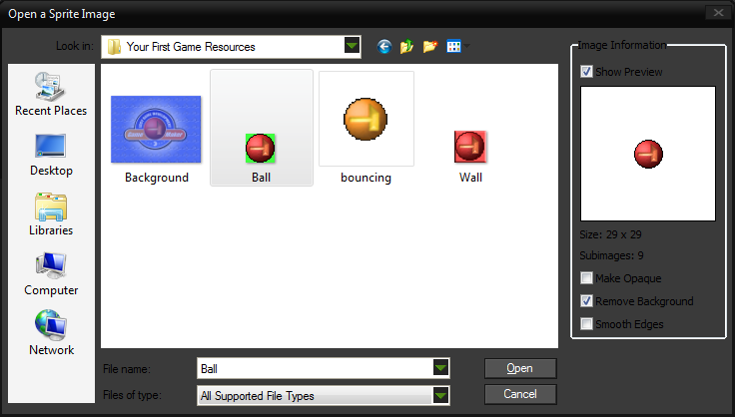
Select the Ball image
Select the Remove Background option.
And click open.
Game Development 1.1
Denis McCarthy

Slide 11
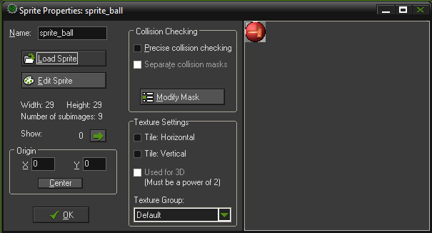
Ball Sprite (Contd…)
Your sprite properties form should now look like.
Click OK to close the form. You have just created your first sprite.
Note: Did you notice the number of sub-images? Click the green arrow to show the sub-images.
Game Development 1.1
Denis McCarthy

Slide 12

About Sprites
Naming Sprites:
  Avoid using spaces or punctuation when naming any resource, as this will confuse GM when using its advanced functions.
  You can use an underscore (_)
Editing existing sprites:
  Once you have created a Sprite you can edit it by double clicking on it and changing its properties.
Game Development 1.1
Denis McCarthy

Slide 13
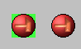
About Sprites (Contd…)
Remove Background option:
  The Remove Background property means that the background of the ball sprite is see through.
  Most sprites are set to transparent so that the surrounding rectangle won’t be drawn when the sprite appears in the game.
  GM works out which colour to make transparent based on the colour in the bottom leftmost corner of each image. This is worth remembering when you want to create your own sprites.
Game Development 1.1
Denis McCarthy

Slide 14
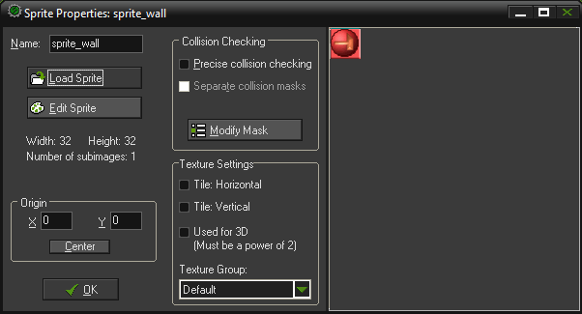
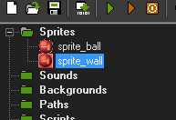
Wall Sprite
From the Resources menu, choose Create Sprite
In the Name field in the Sprite Properties form, type the name sprite_wall.
Click the Load Sprite button and choose the file Wall.gif
Click OK to close the Sprites Properties form.
Game Development 1.1
Denis McCarthy

Slide 15
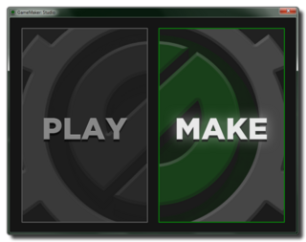
Game Maker Objects
Sprites don’t do anything on their own:
  They just store pictures of the different elements in the game.
Objects are the parts of the game that control how these elements move around and react to each other.
We’ll begin by creating our first object to tell GM how we want the ball to behave.
Game Development 1.1
Denis McCarthy

Slide 16
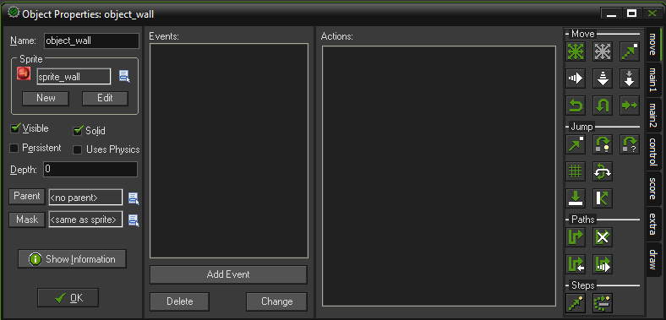
Your first GM Object
Creating a new object and assigning it a sprite.
From the Resources menu, choose Create Object
In the Name field, give the object a name. You should call this one object_wall
Click the icon at the end of the sprite field and a list of all the available sprites will appear. Select the sprite_wall sprite.
Select the Solid check box, so balls can collide with it.
Click OK to create your first object, the wall object.
Game Development 1.1
Denis McCarthy

Slide 17
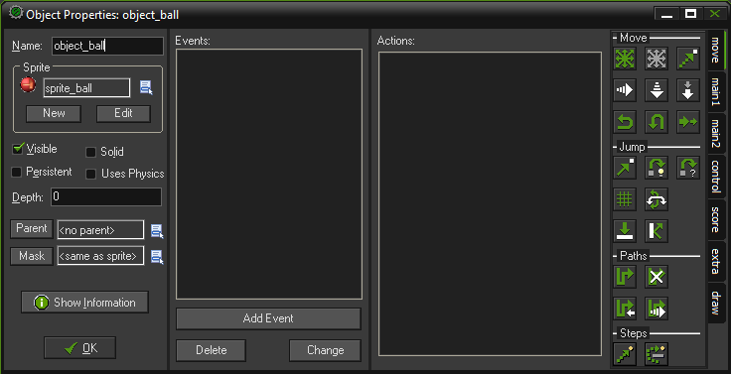
Your second GM Object
From the Resources menu, choose Create Object
In the Name field, give the object a name. You should call this one object_ball
Click the icon at the end of the sprite field and a list of all the available sprites will appear. Select the sprite_ball sprite.
Game Development 1.1
Denis McCarthy

Slide 18
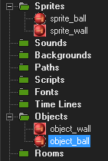
About Objects
Naming Objects:
  Always ensure your object resources names are different from your sprite resources.
  Ending up with an object and sprite both called “Ball” or two objects called “Boss” can confuse the advanced functions of GM.
  Adding prefixes like “sprite_” and “object_” to names is a good way to achieve this without having to think of new names
Game Development 1.1
Denis McCarthy

Slide 19
More about Objects
GM uses events and actions to specify how objects should behave.
Events:
  Are important things that happen in a game
  Such as when objects collide, or a player presses a button.
Actions:
  Are things that happen in response to an event.
  Such as changing an objects direction, setting the score or playing a sound.
Game Development 1.1
Denis McCarthy

Slide 20
More about Objects (Contd…)
GM games are basically just a collection of objects with actions to tell them how to react to different events.
Therefore, to set the behaviour of an object in GM, you must define which events the object should react to and what actions they should perform in response.
Currently the ball object’s list of events are currently empty.
We are going to add an event that will start moving the ball around the screen at the beginning of the game.
This will be complimented by an action that reverses the direction of the ball when it collides with the wall we will create around our playing area.
Game Development 1.1
Denis McCarthy

Slide 21
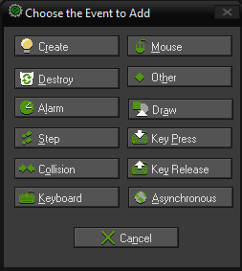
Adding Events
Click the Add Event button. The Event Selector appears as shown below.
Click the Create event to add it to the list of events. A new event is automatically selected (with a blue highlight) in the event list. This means we are already looking at this event’s Actions list alongside it (which is currently empty)
Game Development 1.1
Denis McCarthy

Slide 22
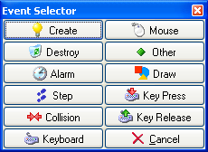
Create Event
The create event is used to set the object instance in motion and/or to set certain variables for the instance .
  Direction
  Speed
When we have created the object, we want some action to be performed on it, in this case we want to set the ball in motion (i.e. get it moving around the screen)
Game Development 1.1
Denis McCarthy

Slide 23
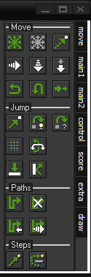
Tab Menu
The actions within GM are sorted into categories.
The different categories can be selected by the tabs at the side.
We will be looking at the different categories throughout the academic year.
Game Development 1.1
Denis McCarthy

Slide 24
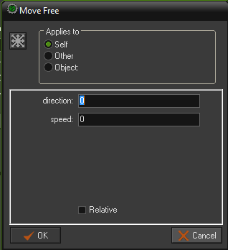
Adding Movement Action
We need to select the Move Free action from the move action tab category. Drag and drop the Move Free icon by holding down the left mouse button. An action form will then pop up asking for particular information about this action.
Game Development 1.1
Denis McCarthy

Slide 25
Move Free Action
Move Free
Here you can indicate a precise direction. This is an angle between 0 and 360 degrees. 0 means to the right. The direction is counter-clockwise. So for example 90 indicates an upward direction. If you want an arbitrary direction, you can type random(360).
Game Development 1.1
Denis McCarthy

Slide 26
Random function
GM provides a number of mathematical functions, random() being one of them
random(x) Returns a random real number between 0 and x. The number is always smaller than x.
E.G. if x is 9, then the function will return a real number from 0 to 8
Game Development 1.1
Denis McCarthy

Slide 27
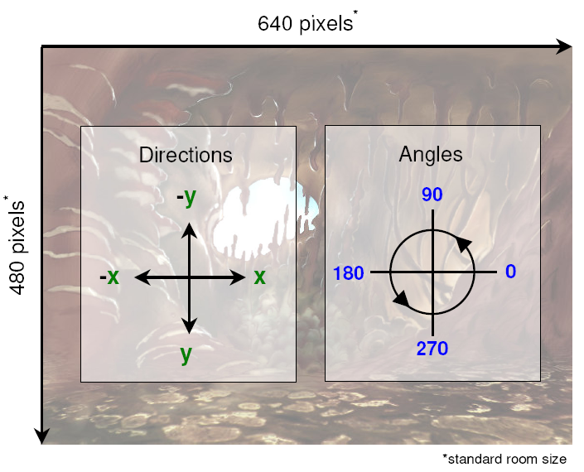
GM Angles and Co-ordinates
Game Development 1.1
Denis McCarthy

Slide 28
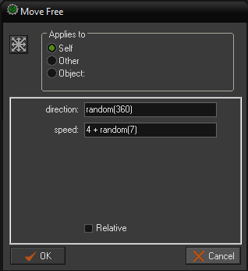
Adding Movement Action
When a ball is created on screen we want it to randomly start moving in any direction. To achieve this we enter the function random(360) into the direction field.
Also we want the speed to be different every time a ball is created on screen, for this, we will create a speed that is between 4 and 10 to do this write in 4 + random(7)
Click on OK to create action.
Game Development 1.1
Denis McCarthy

Slide 29
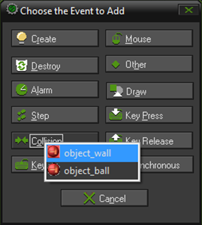
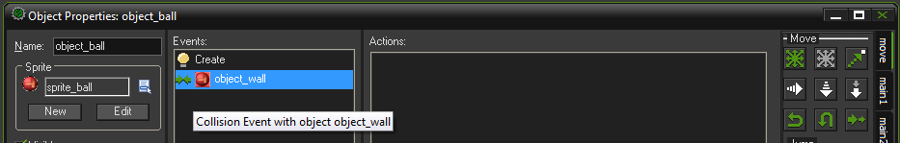
Adding Collision Event
Click the Add Event button. The Event Selector appears as shown below.
Click the Collision event and select object_wall from the drop down menu that appears to add it to the list of events. This action will then be added and selected in the list of events.
Game Development 1.1
Denis McCarthy

Slide 30
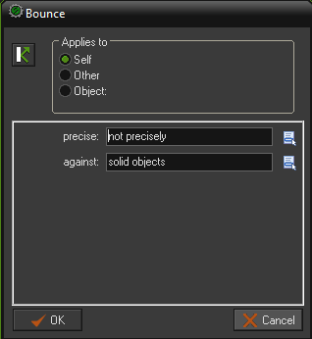
Adding Bounce Action
We need to select the Bounce action from the move action tab category. Drag and drop the Bounce icon by hold down the left mouse button. An action form will then pop up asking for particular information about this action.
Game Development 1.1
Denis McCarthy

Slide 31
Bounce Action
Bounce
When you put this action in the collision event with some object, the instance bounces back from this object in a natural way. If you set the parameter precise to false (Not precisely), only horizontal and vertical walls are treated correctly. When you set precise to true also slanted (and even curved) walls are treated correctly. This is though slower. Also you can indicate whether to bounce only against solid objects or against all objects. Please realize that the bounce is not completely accurate because this depends on many properties. But in many situations the effect is good enough.
Game Development 1.1
Denis McCarthy

Slide 32
Bounce Action Properties
When a ball collides with the wall, we only want it to bounce back from horizontal and vertical walls (i.e. inside a box). To achieve this we select the choice not precisely from the first drop down selection.
When we created the object_wall, we created it as a solid. Therefore we select the choice solid objects from the second drop down selection.
Click on OK to create action.
Game Development 1.1
Denis McCarthy

Slide 33
Story so far
At this point we are nearly ready to test our game so far.
We may not have done much, but we are close.
We just need an environment to play our game in.
Levels in Game Maker are made using rooms.
Putting objects into a room defines where they will appear at the start of the game.
Rooms are where all the action takes place in our game.
Game Development 1.1
Denis McCarthy

Slide 34
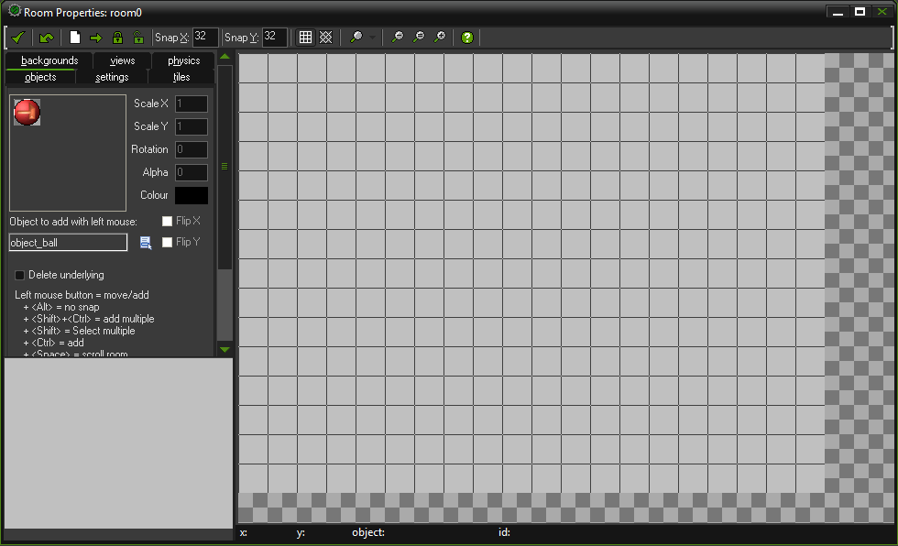
Creating a Room
From the Resources menu, choose Create Room, a Room Properties form will appear as below.
Set both Snap X and Snap Y to 32, this indicates the size in pixels of the grid cells used for aligning objects.
Game Development 1.1
Denis McCarthy

Slide 35
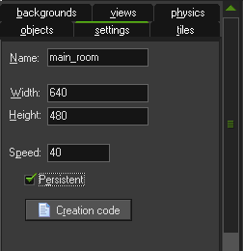
Creating our Room
Click on the settings tab in the top left of the form.
Enter the name for the room in the Name field. Call this one main_room.
The width and height is the size of the room in pixels, 640 and 480 in this instance.
The speed is the number of steps per second. The higher the speed, the smoother the motion is. But you will need a faster computer to run it. We will set the speed to 40
Game Development 1.1
Denis McCarthy

Slide 36
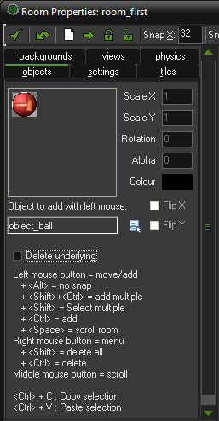
Adding Objects to Rooms
We need to add two objects to our room
  The boundary wall
  The Ball
We will start by placing a ball in the centre of the room.
Click the objects tab in the top left of the form. The ball object is already selected as the object “to add with left mouse”.
On the grey gridded area left click once in the middle of the screen, if you place more than 1 ball you can delete it by right clicking on the extra balls.
Game Development 1.1
Denis McCarthy

Slide 37
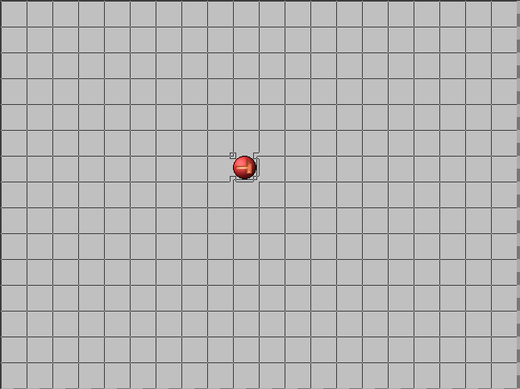
Current view of room
This is where the ball will start moving from in our game.
Make sure to place your ball well away from the edge, as next we will be placing the wall there.
Game Development 1.1
Denis McCarthy

Slide 38
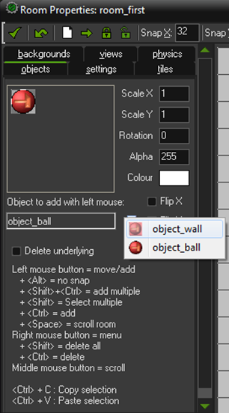
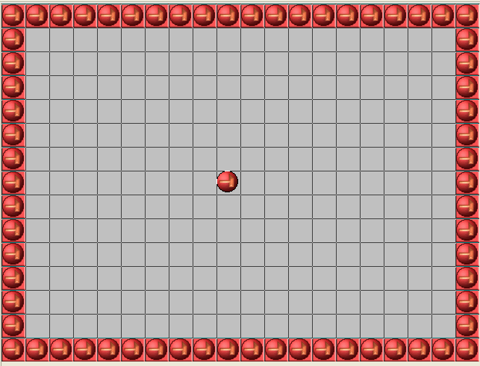
Adding boundary wall
We need to change to the wall object.
To achieve this we select the choice object_wall from the drop down selection.
Now we can add a wall object using the left mouse button. Place wall objects around the perimeter of our playing area. Make sure to leave no gaps
Game Development 1.1
Denis McCarthy

Slide 39

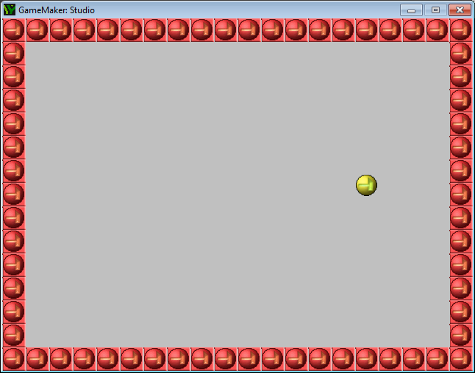
We can now test our game!
We have enough elements created that we can test the game.
To execute/run the game we click on the green play button on the toolbar.
Version 1 of our game:
Game Development 1.1
Denis McCarthy

Slide 40
Doesn’t do much!
Version 1 of our game doesn’t do much, its not a game at all.
We need to add a number of improvements to make a game out of what we have created:
  More balls!!!!
  A background in the room, to make it look better
  Get rid of the psychedelic ball look
  Interactivity to make a game out of it
We want the game to look like this:
Game Development 1.1
Denis McCarthy

Slide 41
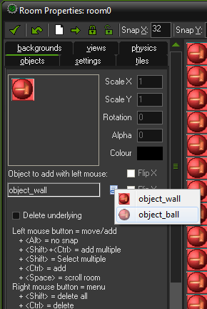
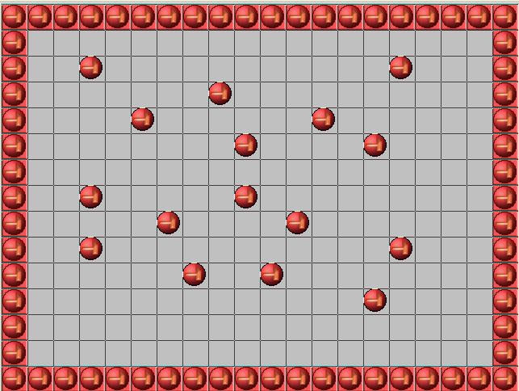
Adding more Balls
We need to change back to the ball object.
To achieve this we select the choice object_ball from the drop down selection.
Now we can add more ball objects using the left mouse button. Place ball objects randomly around our playing area. Make sure not to place them on the boundary wall.
Game Development 1.1
Denis McCarthy

Slide 42
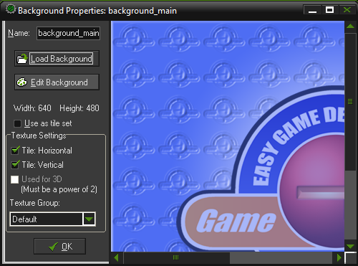
Adding a Background
We need to add a background to our room to make it look better, first we need to create a background resource.
Select Create Background from the Resources menu.
Call the background background_main and click on the Load Background button and choose the file Background.bmp.
Click OK to close the Background Properties form.
Game Development 1.1
Denis McCarthy

Slide 43
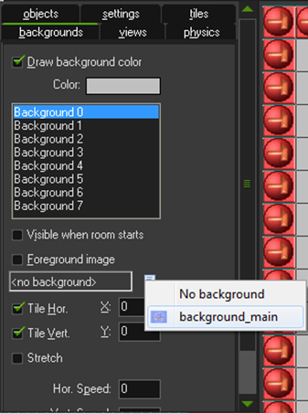
Adding Background to Room
Reopen the properties form for the room by double clicking on it.
Select the Backgrounds tab on the Room Properties form. Click the menu icon to the right of where it says <no background> and select the new background from the pop-up menu.
Close the Room Properties form by clicking on green checkmark in the top-left corner of the form.
Game Development 1.1
Denis McCarthy

Slide 44
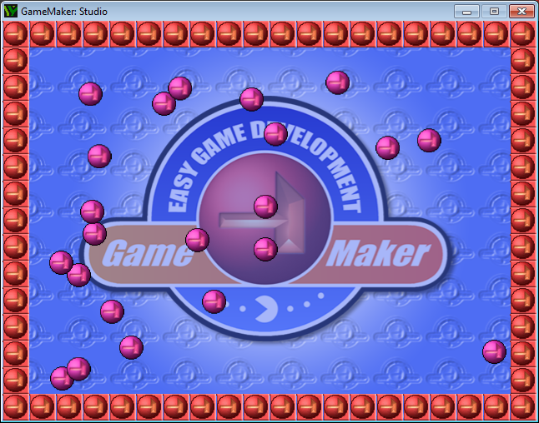
Improvements so far…
After just 2 improvements our game looks much better
Game Development 1.1
Denis McCarthy

Slide 45
Next Improvement
Removing the psychedelic look of the balls.
The reason why the balls have a psychedelic look, is, if you can remember, the sprite_ball had a number of sub-images stored within it.
Currently when we run the game, GM cycles through the sub-images per ball object, which give the psychedelic look as the sub-images are basically balls of different colours.
To solve this we must select one of the images when we create our ball object, to do this we must perform an Action on our Create Event:
This action must:
  Select a sub-image at random
Game Development 1.1
Denis McCarthy

Slide 46
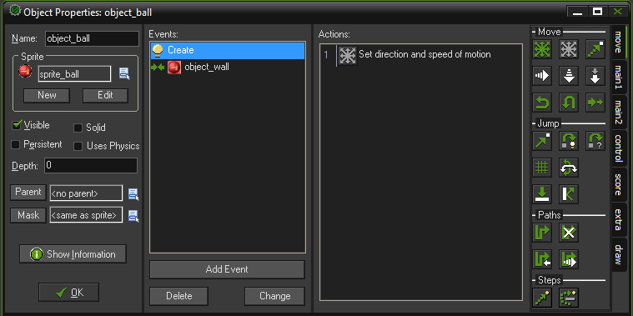
Adding the Action
Reopen the Properties Form for the ball object by double clicking on it.
Since the Create Event is highlighted already (default as it’s the first action in the list) we can just add our action to it.
Game Development 1.1
Denis McCarthy

Slide 47
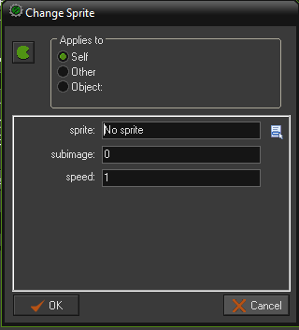
Adding the Action (Contd…)
We need to select the “main1” action category. Within this you need to include the action Change Sprite. To do this, press and hold the left mouse button on the action image with green pac-man image, drag it to the empty Actions list box, and release the mouse button. An action form will then pop up asking for particular information about this action.
Game Development 1.1
Denis McCarthy

Slide 48
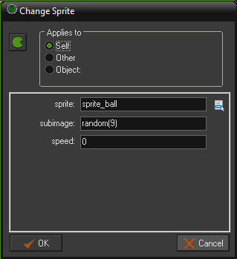
Editing the Action
The action applies to itself, so this property does not change.
Click the icon at the end of the sprite field and a list of all the available sprites will appear. Select the sprite_ball sprite.
Within the sprite_ball image there are 9 sub-images, we want to randomly select one of the images.
Game Development 1.1
Denis McCarthy

Slide 49
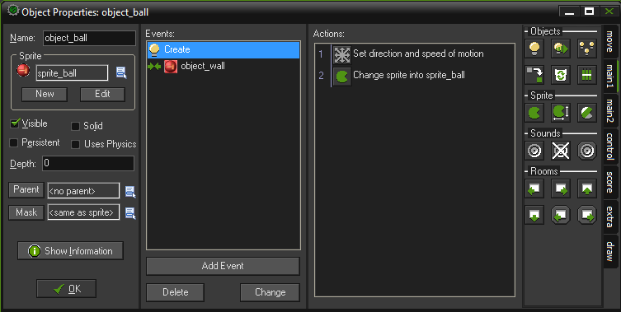
Editing the Action (Contd…)
Within the subimage, write the function random(9)
Set the speed to 0, so that the image is selected instantaneously.
Click OK to close the Action form, and it will be included in the list of actions.
Game Development 1.1
Denis McCarthy

Slide 50
Looking better…
Our game now looks better, sound would be nice and also we are lacking the interactivity that will make it a game.
Game Development 1.1
Denis McCarthy

Slide 51
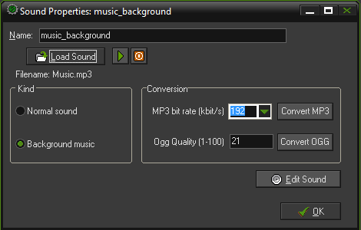
Adding Background Music
We are going to create two sounds
  Music to play in the background.
  A sound when we click on one of the balls to destroy it.
Select Create Sound from the Resources menu.
Call the background music music_background and click on the Load Sound button and choose the file Music.mp3.
Click OK to close the Sound Properties form.
Game Development 1.1
Denis McCarthy

Slide 52
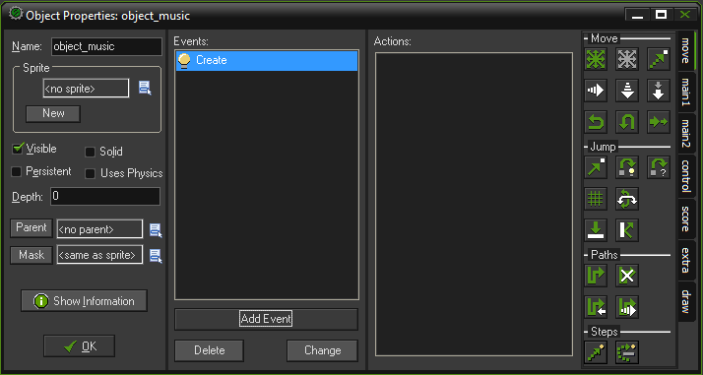
Your third GM Object
From the Resources menu, choose Create Object
In the Name field, give the object a name. You should call this one object_music
We need to add a Create event to get the music playing.
Game Development 1.1
Denis McCarthy

Slide 53
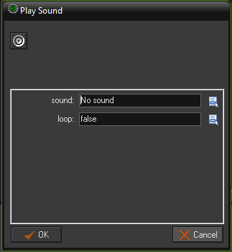
Adding Actions to Event
We need to select the “main1” action category. Within this you need to include the action Play Sound. To do this, press and hold the left mouse button on the first action image under Sound category , drag it to the empty Actions list box, and release the mouse button. An action form will then pop up asking for particular information about this action.
Game Development 1.1
Denis McCarthy

Slide 54
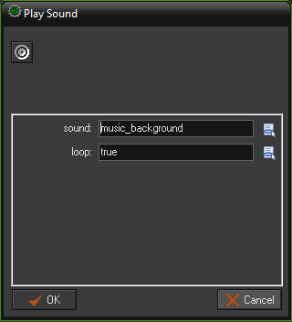
Editing the Action
The action applies to itself, so this property does not change.
Click the icon at the end of the sound field and a list of all the available sounds will appear. Select the music_background sound.
Set the loop property to true, so when the music is finished it will start playing again.
Click on OK to finish.
Game Development 1.1
Denis McCarthy

Slide 55
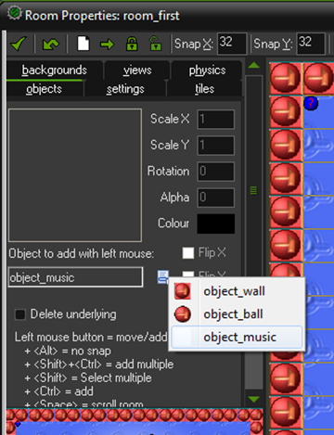
Adding Music Object to Room
Reopen the properties form for the room by double clicking on it.
Select the Objects tab on the Room Properties form. We need to change back to the ball object.To achieve this we select the choice object_music from the drop down selection.
Now we can add a single music object using the left mouse button. Place the music object on a free space in our playing area. Make sure not to overwrite any existing objects in the room.
Close the Room Properties form by clicking on green checkmark in the top-left corner of the form.
Game Development 1.1
Denis McCarthy

Slide 56
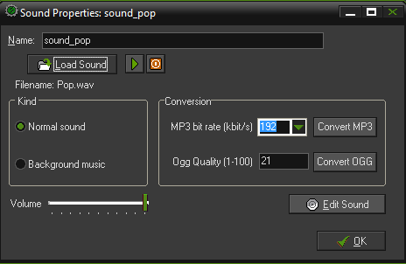
Adding click sound resource
Select Create Sound from the Resources menu.
Call the pop sound sound_pop and click on the Load Sound button and choose the file Pop.wav.
Click OK to close the Sound Properties form.
We don’t need to create an object for this resource as it will be added to the actions associated to the object_ball when a ball is clicked on.
Game Development 1.1
Denis McCarthy

Slide 57
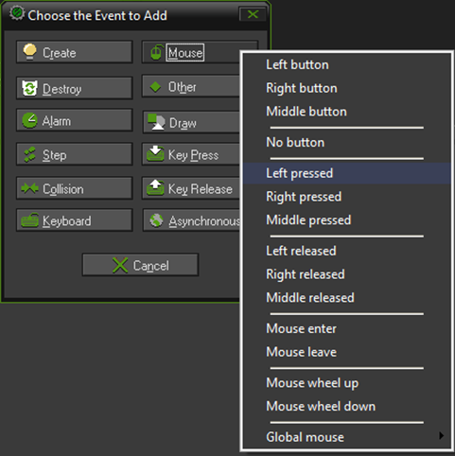
Finally Interactivity
The interactivity is fairly simple, in that all we want to do is click on a ball to destroy it, the actions we will take are based on a mouse clicking event will be:
  Play clicking sound
  Remove ball from game area
Reopen the Properties Form for the ball object by double clicking on it.
Add a Mouse event, and the Left Pressed from the drop down menu
Game Development 1.1
Denis McCarthy

Slide 58
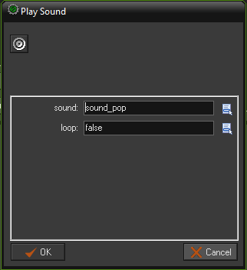
Adding Actions
We need to select the “main1” action category. Within this you need to include the action Play Sound.
Click the icon at the end of the sound field and a list of all the available sounds will appear. Select the sound_click sound.
Set the loop property to false, so when the sound has finished playing it won’t start playing again.
Click on OK to finish.
Game Development 1.1
Denis McCarthy

Slide 59
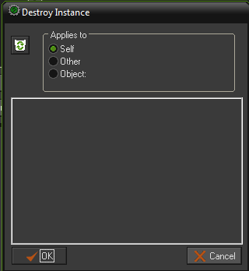
Destroying Ball
Finally we need to destroy the ball we have clicked on.
This is relatively easy, as in object oriented terms we are just destroying the instance of the object.
We need to select the “main1” action category. Within this you need to include the action Destroy Instance.
Since the event that occurred (left mouse click) is specific to a particular ball, we want it to destroy itself. So the Applies to action should be set to Self.
Click on OK to finish.
Game Development 1.1
Denis McCarthy

Slide 60

Adding an icon to your game
Since we have finished our game we need to package it for distribution.
Firstly we need to add an icon so that our game will be instantly recognised within windows
To add an icon image we need to double click on the Global Game Settings
This will bring up the global game settings properties form. Select the Windows tab
Game Development 1.1
Denis McCarthy

Slide 61

Adding an icon to your game
Click on the Update button, this will bring up a windows file chooser, select the file bouncing.ico that is stored with the resources for this game.
Set the display title to “Bouncing Balls”
Click on OK to finish.
Game Development 1.1
Denis McCarthy

Slide 62

Standalone version
Lastly we want to create a final version that works on its own, that is without the need for GM.
To do this simply press the “create a stand-alone” button on the toolbar.
A pop-up window will ask you to save your game in a directory you want.
You can now play the game without the need for GM
Game Development 1.1
Denis McCarthy

Slide 63

Finally Finished
Game Development 1.1
Denis McCarthy

Slide 64
Exercise
We have created a very crude game, but it is playable nonetheless. Lets see if you can make a few minor alterations to it:
Add a Key press (<space>) event to the ball object that changes the colour of ALL the balls randomly.
Start the game with only 1 ball on screen, now every time you destroy a ball, 3 more replace it.
Game Development 1.1
Denis McCarthy

Slide 65

Exercise
Remove the bottom section of the wall (i.e. Make a large whole) and play the game.
Game Development 1.1
Denis McCarthy

Slide 66
Exercise
Update the game so that now every time you click a ball, instead of it being destroyed, is should create 10 more instances of the ball at the same position. (Hint: The light bulb in the Main1 category tab!!!)
Remember to reinstate the bottom wall before you start!!!!
Game Development 1.1
Denis McCarthy

Slide 67
Summary
What did we learn?
  How to create GM resources
    Sprites
    Objects
    Rooms
    Sounds
    Backgrounds
  Added events to objects
    Create
    Mouse clicked
    Key press
    Collisions
  Added actions to events
    Change sprite
    Movement
    Bounce
    Play sound
  Introduce functions
    random()
  Looked at coordinate system
  Made a standalone executable game
Game Development 1.1
Denis McCarthy

